Slide 1
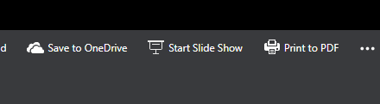

St Vincent De Paul Society
Click Start Slide Show Button to hear music
St Jude’s Conference, Vredenburg
Adopt a Family Project 2024

Slide 2
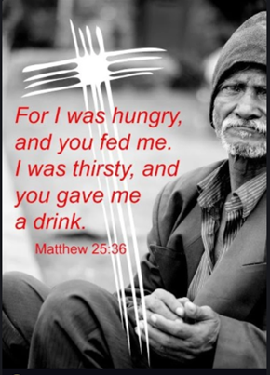

The Lord hears the cry of the Poor

Slide 3
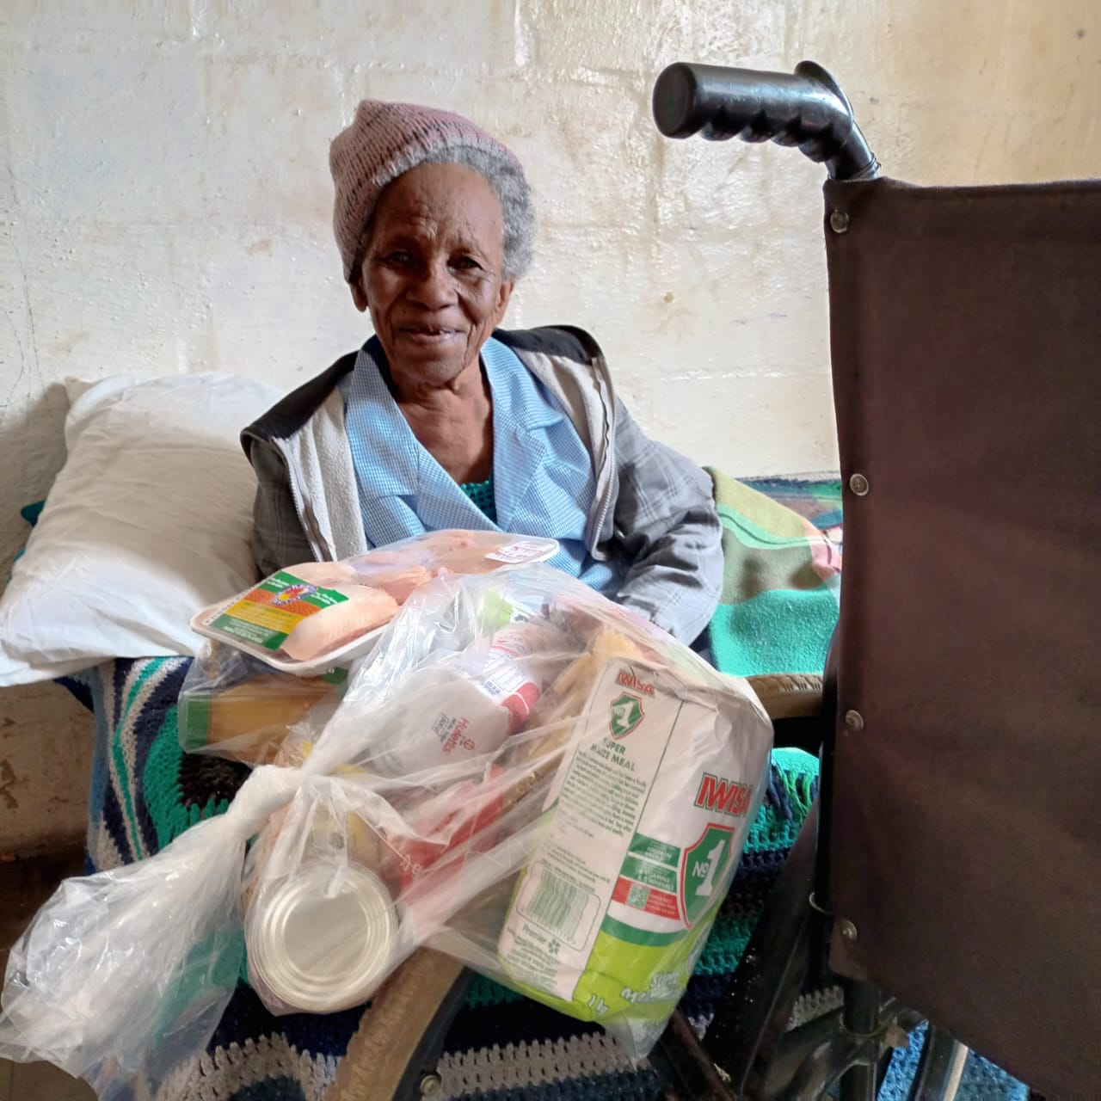

Support our “Adopt A Family” Project
Project will be implemented for Full Year-2024
Donations can be Food Parcels OR EFT R150 per parcel:
Once a Month
Twice a Month
Every Sunday
Nice
Sweet
Awesome

Slide 4




Take an empty ADOPT a FAMILY Plastic Bag in Foyer after Mass
Fill Plastic bag with groceries
Take Plastic Bag Home
Empty Plastic Bags
Ushers takes your parcels to alter
Bring parcels to Church and place in Foyer
Thank you for Adopting A Family

Slide 5
You can also donate R150 instead of a parcel
Once a Month
Nice

Slide 6
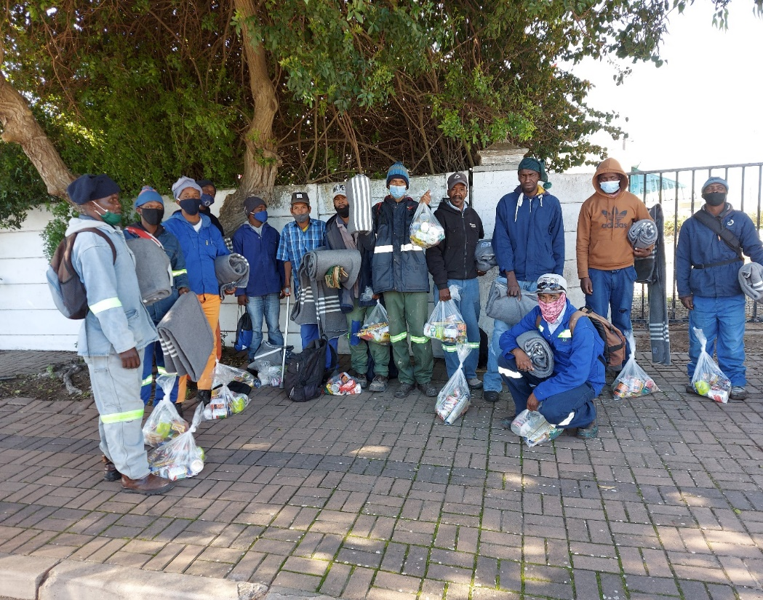
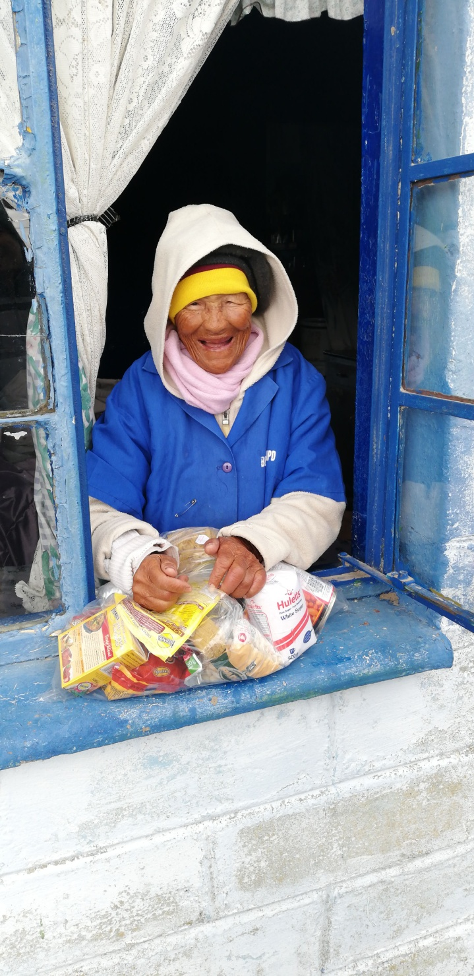
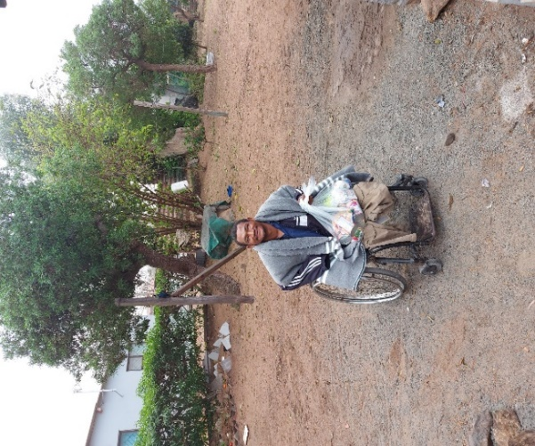
Your are Adopting A Family who are receiving your food parcel
The Lord will say
The Lord will say
When I was Hungry, You Adopted Me

Slide 7
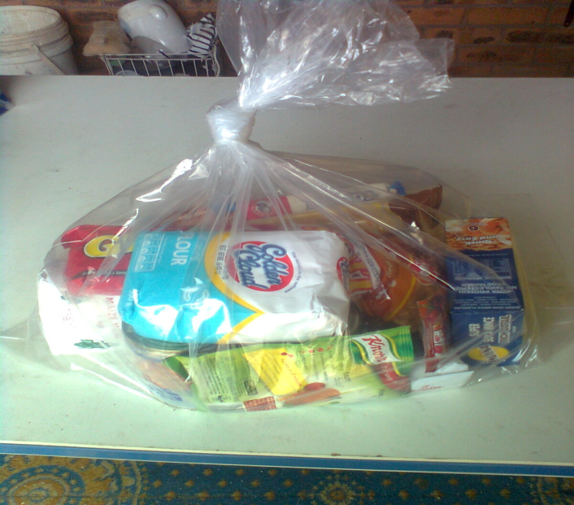
Update Dec 2024: Number of food parcel issued YTD
Actual YTD
1 173 Parcels
Target
1 160 Parcels
Target 2024
Act YTD

Slide 8
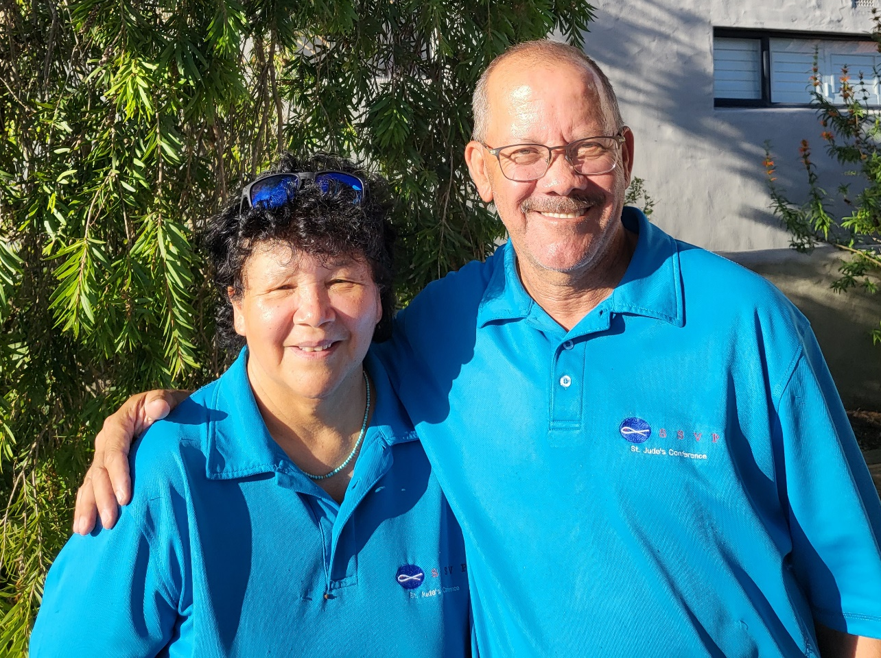
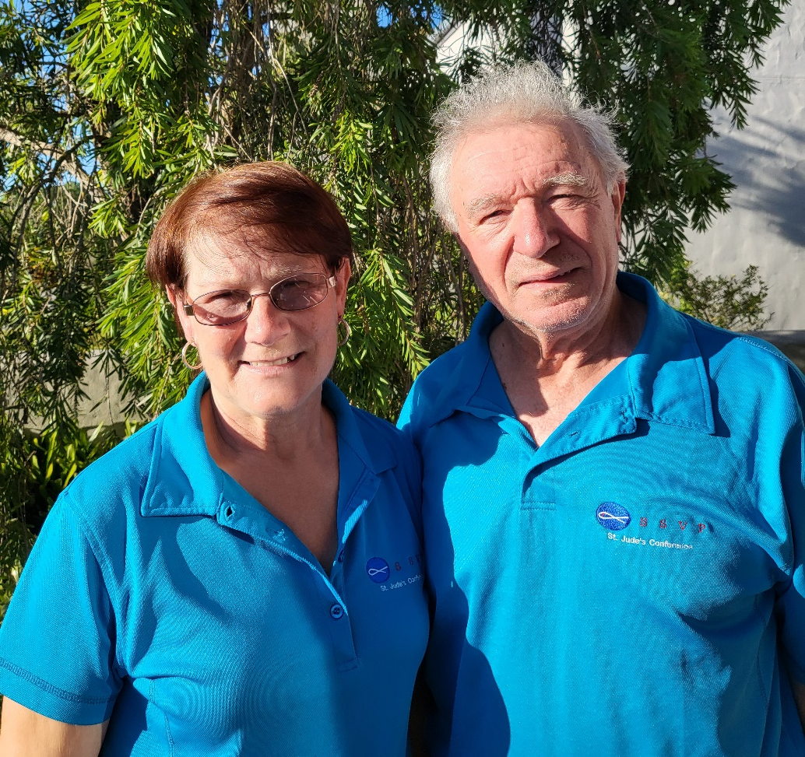
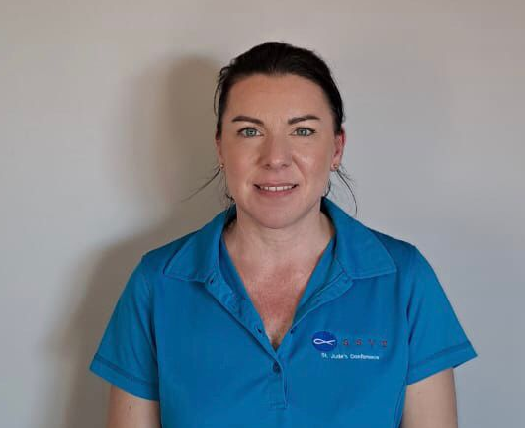
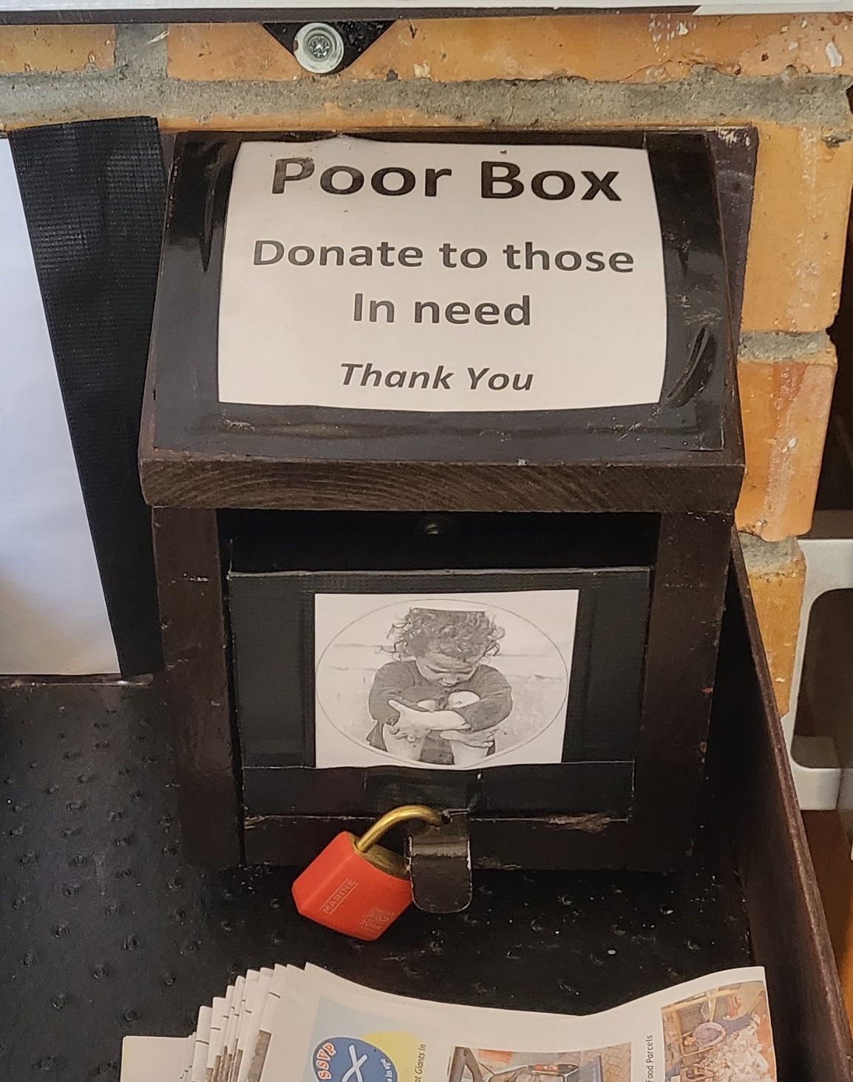
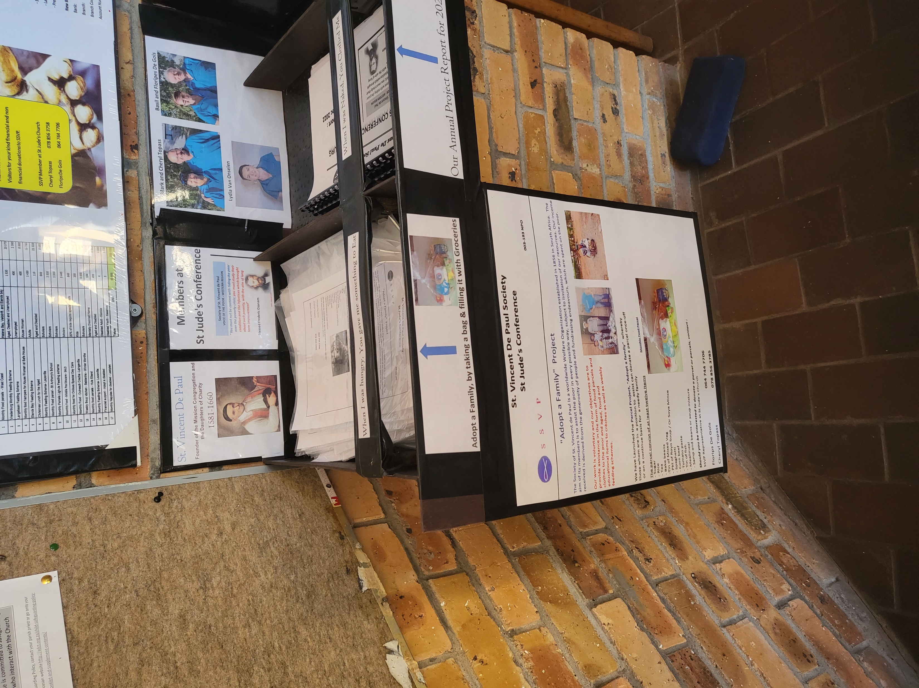
You can also donate R150 instead of a parcel, via the following Options:
Mark & Cheryl Topass Basil and Floripes De Gois Lydia Van Onselen
Some of Our Members
Via EFT
Bank info
In Foyer
Account Name: SSVP Vredenburg St Jude Church
Bank: Standard Bank
Branch: Boksburg
Branch Code: 1842
Account Number: 042 109 744
Or Place donation in Poor Box

Slide 9
Status of our Projects Dec 2024
 | Plan 2024 | YTD Dec 2024
Beneficiaries | 16 851 | 17 853
Expenses | R310 000 | R415 500
Alone our Conference can do so little:
Together, We can do so much

Slide 10
On behalf of our Conference
Thanks for your continuous support

Slide 11


The Lord hears the cry of the Poor
Blessed is the Lord
If You also hear the cry of the Poor you can assist
with a donation of a food parcel parcel/s

